Slide 1
Dividing electrical and mechanical defects of electric motor by short time realizations of vibration signal
Seventeenth International Conference
on Condition Monitoring and Asset Management CM2021
Virtual 14 – 18 June 2021
Sergey N. Boychenko, PhD Alexey V. Kostyukov, PhD
Notes:
Good afternoon dear colleagues!
I would like to present you my next report on the topic:

Slide 2
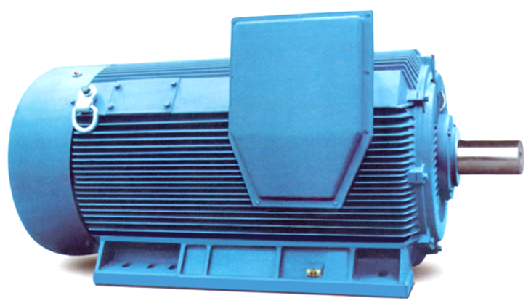
Mechanical impact
(imbalance, misalignment, bearing defects)
Electric nature (defects of stator, rotor)
2
www.dynamics.ru
Notes:
Condition diagnostics and monitoring of machinery by vibration-acoustic diagnostics methods is widely used nowadays in production industries, in order to quit the expensive preventive maintenance and implement an effective modern system of condition-based maintenance.
The effectiveness of a condition monitoring system implementation is mainly determined by the value of the error of the result issued by the expert system.
When we use a method of vibration-acoustic diagnostics of electric motors we face a task of dividing defects into the ones caused by a mechanical impact (imbalance, misalignment, bearing defects) and the ones of electric nature (defects of stator, rotor).
A motor slipping defect causes electric and mechanical components of the spectrum to differ in tenth of a Hz, which requires long (up to ten seconds) signal samples

Slide 3
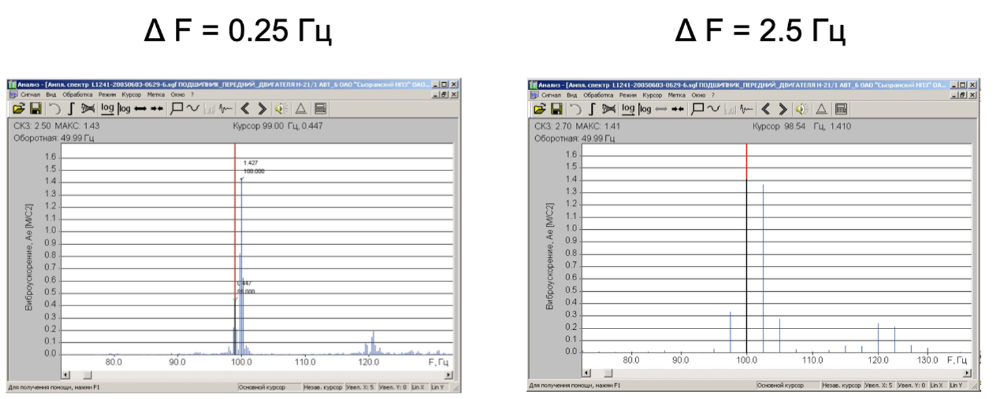
Spectra of a vibration signal of an electric motor, obtained in different frequency resolution
3
www.dynamics.ru
Notes:
This slide shows spectra of a vibration signal of an electric motor, which were obtained in different frequency resolution.
It can be seen, that when the resolution is 2.5 Hz, and the sampling time is 0.4 sec, it is impossible to divide the components using common means.
Excessive sampling lengths can slow down a real-time machinery diagnostic system, which may lead to a defect being missed.
Thus, dividing mechanical and electrical components of a vibration spectrum of an electric motor in short-time signals is an urgent task.

Slide 4
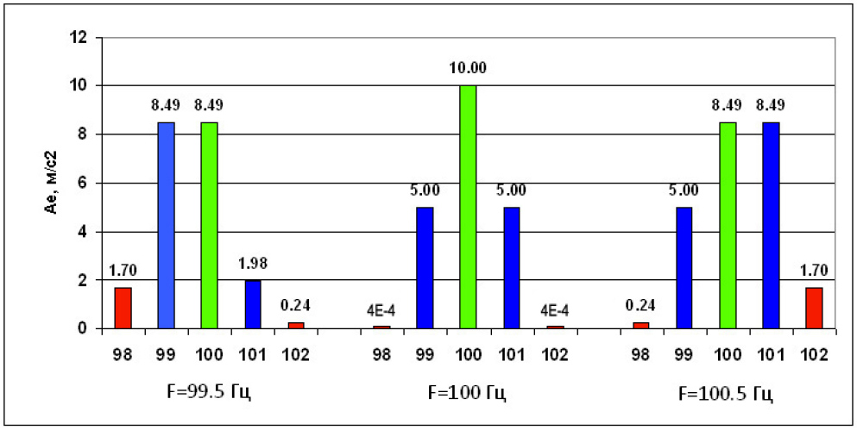
The principle of the interpolation algorithm to obtain adjusted values of the vibration signal’s spectral component frequencies
4
www.dynamics.ru
Notes:
One of such methods is using an interpolation algorithm in order to obtain adjusted values of the vibration signal’s spectral component frequencies. The method is based on adjusting the spectral component frequencies by applying the window interpolation function on amplitudes of the closest frequency components. The principle of the method’s work is shown on this slide.
In the center there is a part of the harmonic spectrum with its frequency matching with the central bandwidth of the spectrum (100 Hz, bandwidth – 1Hz).
On the right and left sides there are the spectrum’s parts when the harmonic frequency is shifted on a half of the spectrum bandwidth up or down (F=99.5 and 100.5 Hz).
It can be seen, that in that case the amplitudes of the closest frequency components are changing, and there is analytic formulae for adjusting the spectral component frequencies of the closest components

Slide 5
$F_{P}=F_{0} ± \frac{2−K_{P}}{1+K_{P}}∙∆F$, where
F₀ – central frequency of the spectrum bandwidth;
ΔF – spectrum bandwidth;
Kp – relation between an amplitude of the central spectrum bandwidth and amplitude of the maximum closest band.
The sign (plus or minus) in the formula depends on the place of the maximum closest band in relation to the central one.
5
www.dynamics.ru
Notes:
Thus, when using Hann Window, the adjusted harmonic Fp will be calculated by the formula:

Slide 6
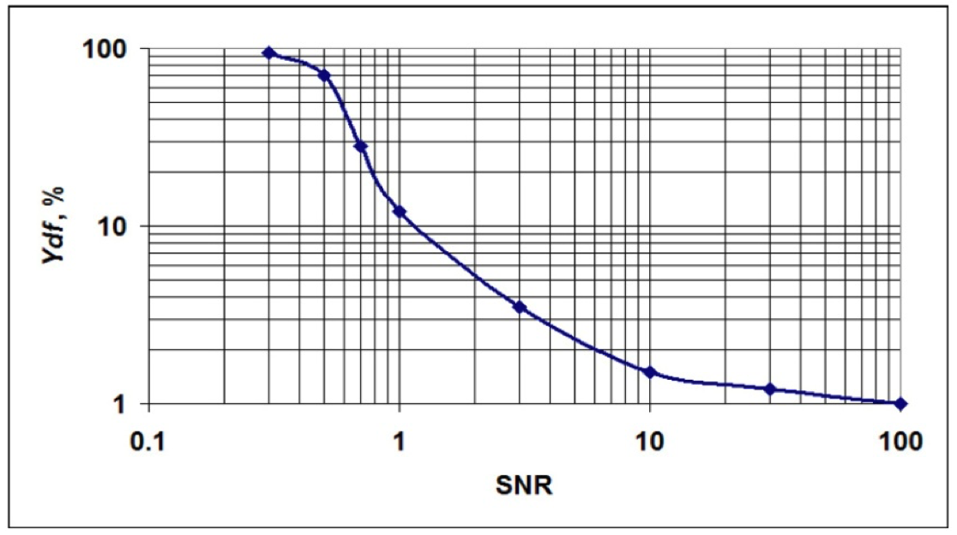
Dependency between harmonic frequency’s interpolation evaluation error and signal-noise relation (SNR)
6
www.dynamics.ru
Notes:
The main disadvantage of the method is a dependency between the accuracy of assessments and the signal’s noise component. Figure on this slide shows a dependency between harmonic frequency’s interpolation evaluation error and signal-noise relation (SNR) for the sinusoidal waveform.
The error in this case was calculated in % depending on the bandwidth of the spectrum analyzer.
It may be noted that, when SNR is low, the error goes to 100% (to the bandwidth of the spectrum analyzer) and when SNR grows the error lowers with a threshold effect when SNR =1.
Theoretically, when there is no noise, the method’s error will be determined by spectrum frequency component amplitudes measuring error.
The given algorithm is successfully applied in monitoring and diagnostic systems, such as using a special sin-cursor option in a spectral analysis. However, the dependency between the method’s error and the noise level leads to necessity to evaluate the real noise rate and consider it in finalizing the assessment.
Currently, it is done manually, and this report is devoted to developing the method of automatic assessment of interpolation method error due to SNR.

Slide 7
Use of this method makes it possible to extract information on relation of adjacent harmonics of a spectrum with low resolution if the following conditions are followed:
- there are two harmonics in the area of analysis;
- a frequency of at least one harmonic is known and fixed.
In case of dividing mechanical and electric components of a vibration spectrum of electric motors both of the requirements are met: there are two harmonics, and the frequency of the electrical harmonic is known and fixed.
7
www.dynamics.ru
Notes:
Use of this method makes it possible to extract information on relation of adjacent harmonics of a spectrum with low resolution if the following conditions are followed:
- there are two harmonics in the area of analysis;
- a frequency of at least one harmonic is known and fixed.
In case of dividing mechanical and electric components of a vibration spectrum of electric motors both of the requirements are met: there are two harmonics, and the frequency of the electrical harmonic is known and fixed.

Slide 8
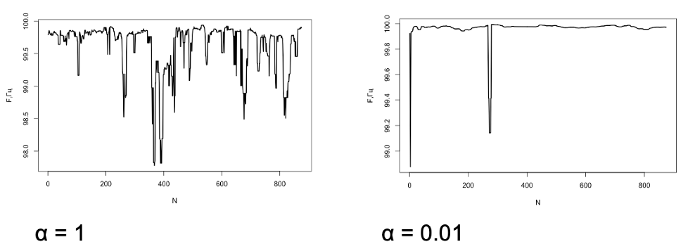
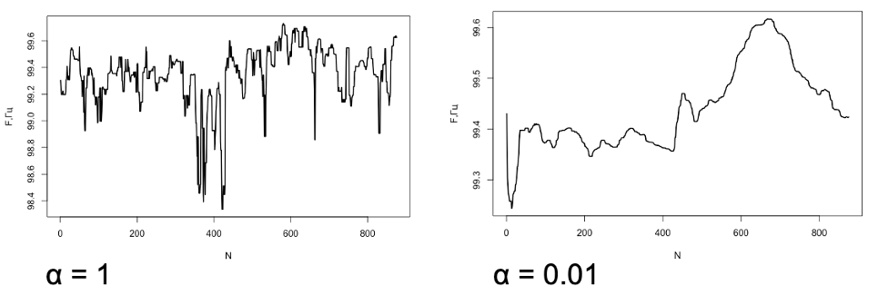
Electric defect
Mechanical defect
8
www.dynamics.ru
Notes:
To reduce a random component in case of a low signal-noise ratio we need to smooth it out (in this particular case we use an exponential smoothing).
This slide shows trends of parameters estimating spectrum frequency in case of electric and mechanical defects respectively.
There are the initial trends with noises, and trends with exponential smoothing.
It can be seen from the figures that in case of an electric defect, the frequency is constant and equals 100 Hz.
In case of a mechanical defect, the frequency changes from 99.4 to 99.8 Hz along with the changes in slipping

Slide 9
Conclusion
Use of an interpolation method for adjusting harmonic frequencies allows estimation of the ratio between the amplitudes of network and rotary harmonics of an electric motor vibration spectrum.
To reduce a random component in case of a low signal-noise ratio, an exponential smoothing is used.
9
www.dynamics.ru

Slide 10
Thank You For Your Attention!
10
www.dynamics.ru

